Slide 1
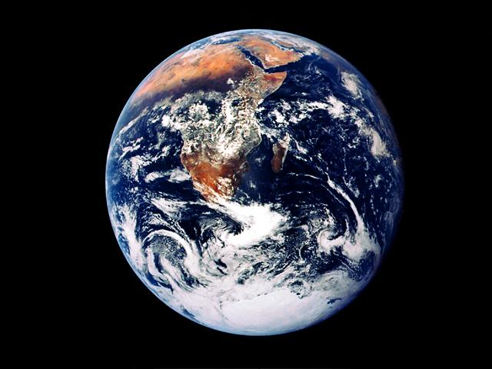
RESURECTION OF TRUE RELIGION
GOD’S CALL TO A DYING WORLD
THE 3 ANGEL’S MESSAGES

Slide 2
A CALL AT THE PRESENT DAY
God is love. It is upon this foundation that we comprehend why there is a present truth that God wants to inculcate in the minds of His people at any time of earth’s history, through all generations... a truth that will root them in the path everlasting: a message of salvation. To this generation God has also left a peculiar truth, a message that is both a call to God, a call from human tradition as well as a warning against persistent disobedience to his light- all laid out in Rev 14:6-12.
“Let he that hath an ear, hear what the spirit is saying to the churches.”

Slide 3
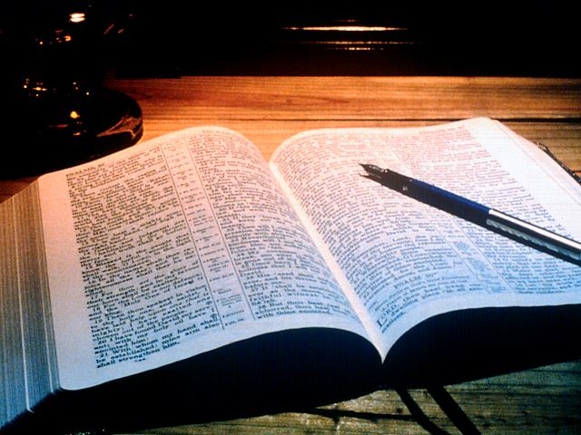
Rev 14
14:6 And I saw another angel fly in the midst of heaven, having the everlasting gospel to preach unto them that dwell on the earth, and to every nation, and kindred, and tongue, and people,

Slide 4
Rev 14
14:7 Saying with a loud voice, Fear God, and give glory to him; for the hour of his judgment is come: and worship him that made heaven, and earth, and the sea, and the fountains of waters.

Slide 5
Rev 14
14:8 And there followed another angel, saying, Babylon is fallen, is fallen, that great city, because she made all nations drink of the wine of the wrath of her fornication.

Slide 6
Rev 14
14:9 And the third angel followed them, saying with a loud voice, If any man worship the beast and his image, and receive [his] mark in his forehead, or in his hand,

Slide 7
Rev 14
14:10 The same shall drink of the wine of the wrath of God, which is poured out without mixture into the cup of his indignation; and he shall be tormented with fire and brimstone in the presence of the holy angels, and in the presence of the Lamb:

Slide 8
Rev 14
14:11 And the smoke of their torment ascendeth up for ever and ever: and they have no rest day nor night, who worship the beast and his image, and whosoever receiveth the mark of his name.

Slide 9
Rev 14
14:12 Here is the patience of the saints: here [are] they that keep the commandments of God, and the faith of Jesus.

Slide 10
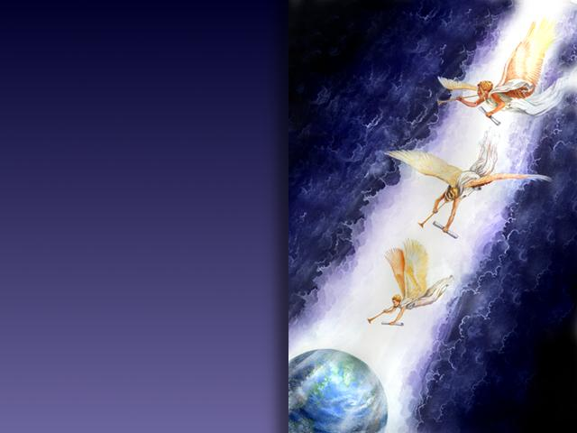
This is the passage of scripture that has commonly come to be known as the
3 angel’s messages
Moshabi Mathuba

Slide 11
1st
Angel
Rev 14:6-7
Moshabi Mathuba

Slide 12
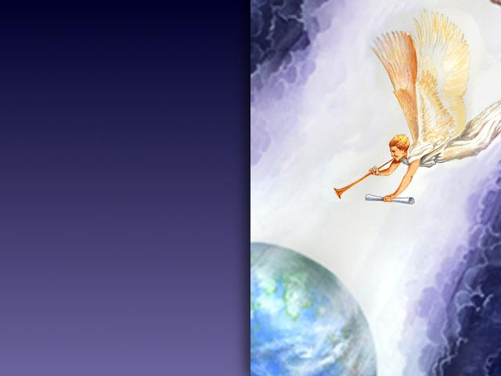
14:6 -7 And I saw another angel fly in the midst of heaven, having the everlasting gospel to preach unto them that dwell on the earth, and to every nation, and kindred, and tongue, and people, Saying with a loud voice, Fear God, and give glory to him; for the hour of his judgment is come: and worship him that made heaven, and earth, and the sea, and the fountains of waters.
Moshabi Mathuba

Slide 13
ANGEL
Ps 104:4 Who maketh his angels spirits; his ministers a flaming fire:
Heb 1:7 And of the angels he saith, Who maketh his angels spirits, and his ministers a flame of fire.
Heb 1:14 Are they not all ministering spirits, sent forth to minister for them who shall be heirs of salvation?
Moshabi Mathuba

Slide 14
ANGEL
The angels are represented as flying in the midst of heaven, proclaiming to the world a message of warning, and having a direct bearing upon the people living in the last days of this earth's history. No one hears the voice of these angels, for they are a symbol to represent the people of God who are working in harmony with the universe of heaven. Men and women, enlightened by the Spirit of God, and sanctified through the truth, proclaim the three messages in their order. {2SM 387.1}
These angels represent those who receive the truth, and with power open the gospel to the world (Letter 79, 1900). {7BC 978.11}
Moshabi Mathuba

Slide 15
FLY IN THE MIDST OF HEAVEN
The third angel is represented as flying in the midst of heaven, showing that the message is to go throughout the length and breadth of the earth. It is the most solemn message ever given to mortals, and all who propose to connect themselves with the work should first feel their need of an education, of the most thorough training. {CT 500.1}
The third angel was seen flying in the midst of heaven, heralding the commandments of God and the faith of Jesus. The message loses none of its power in its onward flight. John saw the work increasing until the whole earth was filled with the glory of God. With intensified zeal and energy we are to carry forward the work of the Lord till the close of time. {CT 548.3}
Moshabi Mathuba

Slide 16
Those who labor in these valleys must take a deep interest in their work, or they will not succeed. The third angel is represented as flying through the midst of heaven. The work is one that must be done quickly. They must keep in working order, laboring intelligently and with consecration, and be prepared by the grace of God to meet opposition. {Ev 423.2}
When God sends to men warnings so important that they are represented as proclaimed by holy angels flying in the midst of heaven, He requires every person endowed with reasoning powers to heed the message. {FLB 286.8}
When will the church do her appointed work? She is represented as an angel of light, flying through heaven with the everlasting gospel to be proclaimed to the world. This represents the speed and directness with which the church is to prosecute her work. {MM 131.5}
Moshabi Mathuba

Slide 17
EVERLASTING GOSPEL
What is the gospel
εὐαγγέλιον
euaggelion
yoo-ang-ghel'-ee-on
a good message, that is, the gospel
What does everlasting mean
αἰώνιος
aiōnios
ahee-o'-nee-os
perpetual (also used of past time, or past and future as well): - eternal, for ever, everlasting, world (began)
STRONG’S HEBREW AND GREEK DICTIONARIES
Moshabi Mathuba

Slide 18
Therefore everlasting gospel means
perpetual good message/news or glad tidings from time past to eternity ahead
Moshabi Mathuba

Slide 19
EVERLASTING?
Gen 3:15
12:1-3
Isa 9:6
Dan 9:25-26
Rev 5:11-13
MATTHEW 24:14
And this gospel of the kingdom shall be preached in all the world for a witness to all nations; then shall the end come.
Moshabi Mathuba

Slide 20
LOUD VOICE
what does it mean to cry/shout/say/speak with a loud voice?
Assignment!
Moshabi Mathuba

Slide 21
Loud voice
Clues
The angel and Abraham
The Levites to Israel
Isaiah to the Israelites
Elizabeth and Mary
The demons to Jesus
Jesus on the cross
Jesus as he returns
Moshabi Mathuba

Slide 22
FEAR GOD
Exodus 20:20 “for God is come to prove you, and that His fear may be before your faces, that ye sin not.” Sin is the transgression of the law (1John 3:4).
Deuteronomy 6:2 “That thou mightest fear the Lord thy God, to keep all his statutes and his commandments…”
Deuteronomy 8:6 “Therefore thou shalt keep the commandments of the
Lord thy God, to walk in his ways, (Ps 77:13) and to fear him.” Deut 14:23
Moshabi Mathuba

Slide 23
FEAR GOD
2Corinthians 7:1” Having therefore these promises, dearly beloved, let us cleanse ourselves from all filthiness of the flesh and spirit, perfecting holiness in the fear of God. Read Matthew 5:48, 1Peter 1:15-2:3.
Psalms 89:7 “God is greatly to be feared in the assembly of the saints, and to be held in reverence of all them that are about him.” Read Leviticus 26:2
Proverbs 3:7 “Be not wise in thine own eyes: fear the Lord, and depart from evil.
Moshabi Mathuba

Slide 24
To fear God means total obedience to all his commandments and statutes with unwavering faith in him. Read also Gen 22:11-12 & Heb 11:6,17-19.
Moshabi Mathuba

Slide 25
It is better to die than to sin; better to want than to defraud; better to hunger than to lie. Let all who are tempted meet Satan with the words: "Blessed is every one that feareth the Lord; that walketh in his ways. For thou shalt eat the labour of thine hands: happy shalt thou be, and it shall be well with thee" (Ps. 128:1, 2). {CC 119.6}
Moshabi Mathuba

Slide 26
GIVE GLORY TO HIM
Matthew 5:16 “Let your light so shine before men, that they may see your good works, and glorify your Father which is in heaven.”
1Corinthians 10:31 “Whether therefore ye eat, or drink, or whatsoever you do, do all to the glory of God “
Ephesians 5:27 “That he might present it to himself a glorious church, not having spot, or wrinkle, or any such thing: but that it should be holy without blemish.”
Jeremiah 9:24 “But let him that glorieth glory in this, that he understandeth and knoweth me…” Read 1John 2:4, Jude 24
Moshabi Mathuba

Slide 27
To give glory to God means to reflect his character in our own. God’s character is revealed to man in his law. It is a practical aspect displayed by works, actions, speech, worship, thought, etc.
Moshabi Mathuba

Slide 28
Not one of us will ever receive the seal of God while our characters have one spot or stain upon them. It is left with us to remedy the defects in our characters, to cleanse the soul temple of every defilement. Then the latter rain will fall upon us as the early rain fell upon the disciples on the Day of Pentecost. {5T 214.2}
Moshabi Mathuba

Slide 29
THE HOUR OF HIS JUDGEMENT
Daniel 7:9,10,13 “I beheld till the thrones were cast down, and the Ancient of days did sit, whose garment was white as snow… the judgment was set, and the books were opened…one like the Son of man came with clouds of heaven, came to the Ancient of days
Moshabi Mathuba

Slide 30
THE HOUR OF HIS JUDGEMENT
When shall these things be?
Daniel 8:13, 14 “How long shall be the vision concerning the daily sacrifice…He said unto me, Unto two thousand and three hundred days’ (2300) then shall the sanctuary be cleansed”
Moshabi Mathuba

Slide 31
THE HOUR OF HIS JUDGEMENT
What does cleansing of the sanctuary bring to mind
...... The day of atonment
Moshabi Mathuba

Slide 32
THE HOUR OF HIS JUDGEMENT
The sanctuary message!
The great day of atonement , with its services so peculiar and impressive... Was a day wherein every man was called to fast and afflict his soul; to mournfully and penitently reflect upon his sinful ways and transgressions... He who failed to mourn was threatened with the penalty of death, as a direct visitation judgement from Jehovah.
Albert Whalley, The red letter days of Israel, p 101
Moshabi Mathuba

Slide 33
THE HOUR OF HIS JUDGEMENT
The sanctuary message!
Let us note well the actual day of atonement. It... Was ushered in by the blowing of the solemn trumpet: emblem of a God coming near in judgement.
Albert Whalley, The red letter days of Israel, p 116
Moshabi Mathuba

Slide 34
THE HOUR OF HIS JUDGEMENT
The sanctuary message!
So awful was the day of atonement that were told in a Jewish book of ritual that the very angels run to fro in fear and trembling, saying, ‘lo, the day of judgment has come’
F.W Farrar. The early days of Christianity, pp 237-8
Moshabi Mathuba

Slide 35
WORSHIP HIM
WHAT
WHO
WHY
WHEN,
HOW
Moshabi Mathuba

Slide 36
WORSHIP
“WORSHIP HIM THAT MADE HEAVEN, AND EARTH, AND THE SEA, AND THE FOUNTAINS OF WATERS”
Where have we heard this statement before?
Moshabi Mathuba

Slide 37
WORSHIP
“WORSHIP HIM THAT MADE HEAVEN, AND EARTH, AND THE SEA, AND THE FOUNTAINS OF WATERS”
Where have we heard this statement before?
Yes indeed
GEN but more specifically Ex 20:8-11
Moshabi Mathuba

Slide 38
2nd
Angel
Rev 14:8
Moshabi Mathuba

Slide 39
Rev 14:8 And there followed another angel, saying, Babylon is fallen, is fallen, that great city, because she made all nations drink of the wine of the wrath of her fornication.
Moshabi Mathuba

Slide 40
Babylon
An ancient city on the left bank of the Euphrates, about 70 miles south of Bagdad. Babylon is the Greek form of Babel or Bab-ili, “the gate of the god” which again is Semitic translation of the original Sumerian name Ka-dimirra. The god was probably Merodach or Marduk, the divine patron of the city
The encyclopaedia Britannica. 1911, Eleventh edition

Slide 41
Daniel 3:1-6” Nebuchadnezzar the king made an image…the king sent to gather together the princes, the governors, and the captains, the judges, the treasurers, the counselors, the sheriffs…to come to the dedication of the image…Then a herald cried aloud, To you it is commanded, O people, nations, and languages, that at what time ye hear the sound…ye fall down and worship the golden image…whoso falleth not down and worshippeth shall the same hour be cast into the midst of a burning fiery furnace...”

Slide 42
Dan 5:1-4 Belshazzar the king made a great feast to a thousand of his lords, and drank wine before the thousand. Belshazzar, whiles he tasted the wine, commanded to bring the golden and silver vessels which his father Nebuchadnezzar had taken out of the temple which [was] in Jerusalem; that the king, and his princes, his wives, and his concubines, might drink therein. Then they brought the golden vessels that were taken out of the temple of the house of God which [was] at Jerusalem; and the king, and his princes, his wives, and his concubines, drank in them.They drank wine, and praised the gods of gold, and of silver, of brass, of iron, of wood, and of stone.

Slide 43
Gen
11:1-5 And the whole earth was of one language, and of one speech. And it came to pass, as they journeyed from the east, that they found a plain in the land of Shinar; and they dwelt there. And they said one to another, Go to, let us make brick, and burn them thoroughly. And they had brick for stone, and slime had they for mortar. And they said, Go to, let us build us a city and a tower, whose top [may reach] unto heaven; and let us make us a name, lest we be scattered abroad upon the face of the whole earth. And the LORD came down to see the city and the tower, which the children of men builded.

Slide 44
Gen
11:6-9 And the LORD said, Behold, the people [is] one, and they have all one language; and this they begin to do: and now nothing will be restrained from them, which they have imagined to do. Go to, let us go down, and there confound their language, that they may not understand one another's speech. So the LORD scattered them abroad from thence upon the face of all the earth: and they left off to build the city. Therefore is the name of it called Babel; because the LORD did there confound the language of all the earth: and from thence did the LORD scatter them abroad upon the face of all the earth.

Slide 45
Babylon
Nebuchadnezzar
acting in defiance of the interpretation dream in Dan 2
Belshazzar
Defilement of God’s utensil and belettling Him in relation to his gods
After the flood
Wanted to out smart God

Slide 46
Babylon
Characteristics
Defiance of God and His ways/judgements
Man made initiations
An amalgam of state and religion
Includes all people or at least their leadership

Slide 47
Wine
Isa 28:7 But they also have erred through wine, and through strong drink are out of the way; the priest and the prophet have erred through strong drink, they are swallowed up of wine, they are out of the way through strong drink; they err in vision, they stumble [in] judgment.

Slide 48
Wine
Matt 22:29 Jesus answered and said unto them, Ye do err, not knowing the scriptures, nor the power of God

Slide 49
Wine
Matt 9:17 Neither do men put new wine into old bottles: else the bottles break, and the wine runneth out, and the bottles perish: but they put new wine into new bottles, and both are preserved.

Slide 50
Wine
Rev 6:6 And I heard a voice in the midst of the four beasts say, A measure of wheat for a penny, and three measures of barley for a penny; and [see] thou hurt not the oil and the wine.

Slide 51
Wine
Wine is therefore a symbol of doctrines

Slide 52
FORNICATION
Revelation 2:20
1 Kings 21:25; 16:31
2 Kings 9:22
2 Chro 21:11
Ezek 16:29
Hosea 1:2
Fornication is a symbol worship of other gods
(wrath in this case refers to intense passion)
Moshabi Mathuba

Slide 53
3rd
Angel
Rev 14:9-12
Moshabi Mathuba

Slide 54
14:9-12 And the third angel followed them, saying with a loud voice, If any man worship the beast and his image, and receive [his] mark in his forehead, or in his hand, The same shall drink of the wine of the wrath of God, which is poured out without mixture into the cup of his indignation; and he shall be tormented with fire and brimstone in the presence of the holy angels, and in the presence of the Lamb: And the smoke of their torment ascendeth up for ever and ever: and they have no rest day nor night, who worship the beast and his image, and whosoever receiveth the mark of his name. Here is the patience of the saints: here [are] they that keep the commandments of God, and the faith of Jesus.
Moshabi Mathuba

Slide 55
Worship.....
Its all about worship, always was , always will be
Remember yesterday’s presentation!
By worshiping the beast, worship is channelled to the dragon (Rev 13:4) .... Remember the 2nd presentation!
Moshabi Mathuba

Slide 56
The beast....
Moshabi Mathuba

Slide 57
The beast.... This calls for earnest study of Rev 13
Moshabi Mathuba

Slide 58
Image of the beast
The "image to the beast" represents that form of apostate Protestantism which will be developed when the Protestant churches shall seek the aid of the civil power for the enforcement of their dogmas. . . . {FLB 286.4}
The image of the beast is some ecclesiastical combination which will resemble the beast in being clothed with power to enforce its decrees with the pains and penalties of the civil law. The two horned beast by which the image is given power to speak and act, represents the United States of America, which is moving toward the formation of the image of the beast. Daniel and the revelation. U Smith. Pg 667
Moshabi Mathuba

Slide 59
Image of the beast= combination of church and state(politics and religion)
Moshabi Mathuba

Slide 60
Mark of the beast
1st let us consider the mark of God
God’s Sign: seventh day Sabbath. Exodus 31:12-17, Ezekiel 20:12, 20
Moshabi Mathuba

Slide 61
Mark of the beast
Now that we have identified the mark/sign of God... Lets then identify the mark of the beast
We observe Sunday instead of Saturday because the Catholic Church, in the Council of Laodicea (A. D. 336), transferred the solemnity from Saturday to Sunday.” Rev. Peter Geiermann, The Convert’s Catechism of Catholic Doctrine, (St. Louis: B. Herder Book Company, 1957 edition) p. 50.
Moshabi Mathuba

Slide 62
“The Divine institution of a day of rest from ordinary occupations and of religious worship, transferred by the authority of the Church from the Sabbath, the last day, to Sunday, the first day of the week, . . .is one of the most patent signs that we are a Christian people.” James Cardinal Gibbons, as quoted in, John Gilmary Shea and others, The Cross and the Flag, “The Claims of the Catholic Church in the Making of the Republic,” (New York: The Catholic Historical Leage of America, 1899), pp. 24
Moshabi Mathuba

Slide 63
Pay special attention to where the mark is placed... “in his forehead, or in his hand”
Read Deut 6:6-8
The devil does not create but makes a counterfeit
Moshabi Mathuba

Slide 64
God gives a stern warning to all such as are involved
Rev 14:10
“The same shall drink of the wine of the wrath of God, which id poured out without mixture (justice without mercy) into the cup of his indignation...”
Note
-The are consumed with fire and brimstone
In the presence of the angels and the lamb
- The smoke of their torment ascendeth forever and ever ( eternal punishment not punishing)
Moshabi Mathuba

Slide 65
The final word of encouragement to the saints
“here is the patience of the saints, here are they that keep the commandments of God and have the faith of Jesus”
Moshabi Mathuba

Slide 66
Moshabi Mathuba

Slide 67
Moshabi Mathuba

Slide 68
Babylon.... fallen
What does it mean its fallen?
Has babylon ever stood?

Slide 69
Babylon.... fallen
It is our individual duty to walk humbly with God. We are not to seek any strange, new message. We are not to think that the chosen ones of God who are trying to walk in the light, compose Babylon. The fallen denominational churches are Babylon. Babylon has been fostering poisonous doctrines, the wine of error. This wine of error is made up of false doctrines, such as the natural immortality of the soul, the eternal torment of the wicked, the denial of the pre-existence of Christ prior to His birth in Bethlehem, and advocating and exalting the first day of the week above God's holy, sanctified day. These and kindred errors are presented to the world by the various churches. . . . {Ev 365.1}

Slide 70
Babylon.... fallen
As the churches refused to receive the first angel's message, they rejected the light from heaven and fell from the favor of God. EW 237

Slide 71
Babylon.... fallen
The churches then experienced a moral fall, in consequence of their refusal of the light of the Advent message; but that fall was not complete. As they have continued to reject the special truths for this time, they have fallen lower and lower. Not yet, however, can it be said that "Babylon is fallen, . . . because she made all nations drink of the wine of the wrath of her fornication." She has not yet made all nations do this. . . . The work of apostasy has not yet reached its culmination. {FLB 285.2

Slide 72
Babylon.... fallen
The Bible declares that before the coming of the Lord, Satan will work "with all power and signs and lying wonders, and with all deceivableness of unrighteousness;" and they that "received not the love of the truth, that they might be saved," will be left to receive "strong delusion, that they should believe a lie." 2 Thess. 2:9-11. Not until this condition shall be reached, and the union of the church with the world shall be fully accomplished throughout Christendom, will the fall of Babylon be complete. The change is a progressive one, and the perfect fulfillment of Revelation 14:8 is yet future. {FLB 285.3}

Slide 73
Babylon.... fallen
The second angel's message of Revelation 14 was first preached in the summer of 1844, and it then had a more direct application to the churches of the United States, where the warning of the judgment had been most widely proclaimed and most generally rejected, and where the declension in the churches had been most rapid. But the message of the second angel did not reach its complete fulfillment in 1844. {FLB 285.2}

Slide 74
Can it be possible that God has a particular message that He wants to give across to all of us now.... A present truth- for our own salvation and for all those around us?

Slide 75
Let us observe this angel more closely, of the three he is the only one not crying with a loud voice
Have you ever asked yourself the significance of this?
Moshabi Mathuba

Slide 76
1 Kin 19:11 And he said, Go forth, and stand upon the mount before the LORD. And, behold, the LORD passed by, and a great and strong wind rent the mountains, and brake in pieces the rocks before the LORD; [but] the LORD [was] not in the wind: and after the wind an earthquake; [but] the LORD [was] not in the earthquake:
19:12 And after the earthquake a fire; [but] the LORD [was] not in the fire: and after the fire a still small voice.
Moshabi Mathuba

Slide 77
Ecc 9:17 The words of wise [men are] heard in quiet more than the cry of him that ruleth among fools.
Moshabi Mathuba

Slide 78
the still voice or low voice thus implied shows, God’s appeal to reason
Moshabi Mathuba

Slide 79
Isa 1:18 Come now, and let us reason together, saith the LORD: though your sins be as scarlet, they shall be as white as snow; though they be red like crimson, they shall be as wool.
Moshabi Mathuba

Slide 80
The Comforter is called "the Spirit of truth." His work is to define and maintain the truth. He first dwells in the heart as the Spirit of truth, and thus He becomes the Comforter. There is comfort and peace in the truth, but no real peace or comfort can be found in falsehood. It is through false theories and traditions that Satan gains his power over the mind. By directing men to false standards, he misshapes the character. Through the Scriptures the Holy Spirit speaks to the mind, and impresses truth upon the heart. Thus He exposes error, and expels it from the soul. It is by the Spirit of truth, working through the word of God, that Christ subdues His chosen people to Himself. {DA 671.1}
Moshabi Mathuba

Slide 81
The second angel portrays the act of God talking and reasoning with his people
Moshabi Mathuba

Slide 82
Ps 95:7-8 For he [is] our God; and we [are] the people of his pasture, and the sheep of his hand. To day if ye will hear his voice, Harden not your heart, as in the provocation, [and] as [in] the day of temptation in the wilderness: (see also Heb 3)
Moshabi Mathuba

Slide 83
Many a christian/SDA tend to believe that the 2nd angels message is meant for other people but not themselves!
Have you thought otherwise

Slide 84
Remember- wine of error
doctrines such as
natural immortality of the soul,
the eternal torment of the wicked,
the denial of the pre-existence of Christ
advocating and exalting the first day of the week

Slide 85
War, oppression, the worship of mammon, pursuit of pleasure, the maintenance of very many errors of the roman catholic church , identify with sad and faithful accuracy the great body of the protestant churches as an important constituent part of the great Babylon.
Daniel and the Revelation. Uriah Smith. Pg 647
Moshabi Mathuba

Slide 86
Do you in any way happen to identify with any of the above?
If you, are the message from the Lord...
Come now let us reason together- the Laodecian message
Moshabi Mathuba

Slide 87
There is but one church in the world who are at the present time standing in the breach, and making up the hedge, building up the old waste places; and for any man to call the attention of the world and other churches to this church, denouncing her as Babylon, is to do a work in harmony with him who is the accuser of the brethren. {FLB 305.5}
Moshabi Mathuba

Slide 88
How Satan would exult to have a message go broadcast that the only people whom God has made the repositories of His law are the ones to whom this message applies. The wine of Babylon is the exalting of the false and spurious sabbath above the Sabbath which the Lord Jehovah hath blessed and sanctified for the use of man, also [it is] the immortality of the soul. These kindred heresies, and the rejection of the truth, convert the church into Babylon. Kings, merchants, rulers, and religious teachers are all in corrupt harmony. {2SM 68.2}
Moshabi Mathuba

Slide 89
The Message to the Laodiceans
God is leading out a people. He has a chosen people, a church on the earth, whom He has made the depositaries of His law. He has committed to them sacred trust and eternal truth to be given to the world. He would reprove and correct them. The message to the Laodiceans is applicable to Seventh-day Adventists who have had great light and have not walked in the light. It is those who have made great profession, but have not kept in step with their Leader, that will be spewed out of His mouth unless they repent. The message to pronounce the Seventh-Day Adventist Church Babylon, and call the people of God out of her, does not come from any heavenly messenger, or any human agent inspired by the Spirit of God. {2SM 66.2}
Moshabi Mathuba

Slide 90
God calls us to ressurect from our slumber, to seek the old paths and walk therein(Jer 6:16) to remember whence we have fallen and do the first things(Rev 2:5) to earnestly contend for the faith which was once delivered to the saints(Jude 3)
Moshabi Mathuba

Slide 91
Let all be careful not to make an outcry against the only people who are fulfilling the description given of the remnant people, who keep the commandments of God and have faith in Jesus. . . . God has a distinct people, a church on earth, second to none, but superior to all in their facilities to teach the truth, to vindicate the law of God. . . . My brother, if you are teaching that the Seventh-day Adventist Church is Babylon, you are wrong.--TM 50, 58, 59 (1893). [THE BOOK OF REVELATION FOCUSES ON TWO SETS OF GOD'S PEOPLE--THE VISIBLE REMNANT (12:17) AND "MY PEOPLE" IN BABYLON (18:4). THIS CHAPTER DEALS WITH THE FORMER, AND CHAPTER 14, "THE LOUD CRY," DEALS WITH THE LATTER.] {LDE 43.3} Chap 4, God's Last Day Church.
Moshabi Mathuba

Slide 92
MEETING THE CHARGE THAT THE CHURCH HAD BECOME BABYLON, ELLEN G. WHITE WROTE: "THE CHURCH, ENFEEBLED AND DEFECTIVE, NEEDING TO BE REPROVED, WARNED, AND COUNSELED, IS THE ONLY OBJECT UPON EARTH UPON WHICH CHRIST BESTOWS HIS SUPREME REGARD."--TESTIMONIES TO MINISTERS, P. 49

Slide 93
Remember Rev 12.... The woman on the moon

Slide 94
Do you remember the characteristics of the remnant of her seed?
“keep the commandments of God and have the faith of Jesus Christ”

Slide 95
Do you identify with her?

Slide 96
How well do you endeavour to keep the commandments of God
Do you believe in a life of perfection in Jesus Christ
Do you believe in Righteousness by faith
Do you believe in the sanctuary message
Do you believe in health reform
Do you believe in dress reform
Do you believe in reverent worship
Do you believe in the testimony of Jesus/SOP
Moshabi Mathuba

Slide 97
How well do you endeavour to keep the commandments of God
Do you believe in a life of perfection in Jesus Christ
Do you believe in Righteousness by faith
Do you believe in the sanctuary message
Do you believe in health reform
Do you believe in dress reform
Do you believe in reverent worship
Do you believe in the testimony of Jesus/SOP
Moshabi Mathuba

Slide 98
How well do you endeavour to keep the commandments of God
Do you believe in a life of perfection in Jesus Christ
Do you believe in Righteousness by faith
Do you believe in the sanctuary message
Do you believe in health reform
Do you believe in dress reform
Do you believe in reverent worship
Do you believe in the testimony of Jesus/SOP
Moshabi Mathuba

Slide 99
How well do you endeavour to keep the commandments of God
Do you believe in a life of perfection in Jesus Christ
Do you believe in Righteousness by faith
Do you believe in the sanctuary message
Do you believe in health reform
Do you believe in dress reform
Do you believe in reverent worship
Do you believe in the testimony of Jesus/SOP
Moshabi Mathuba

Slide 100
How well do you endeavour to keep the commandments of God
Do you believe in a life of perfection in Jesus Christ
Do you believe in Righteousness by faith
Do you believe in the sanctuary message
Do you believe in health reform
Do you believe in dress reform
Do you believe in reverent worship
Do you believe in the testimony of Jesus/SOP
Moshabi Mathuba

Slide 101
How well do you endeavour to keep the commandments of God
Do you believe in a life of perfection in Jesus Christ
Do you believe in Righteousness by faith
Do you believe in the sanctuary message
Do you believe in health reform
Do you believe in dress reform
Do you believe in reverent worship
Do you believe in the testimony of Jesus/SOP
Moshabi Mathuba

Slide 102
How well do you endeavour to keep the commandments of God
Do you believe in a life of perfection in Jesus Christ
Do you believe in Righteousness by faith
Do you believe in the sanctuary message
Do you believe in health reform
Do you believe in dress reform
Do you believe in reverent worship
Do you believe in the testimony of Jesus/SOP
Moshabi Mathuba

Slide 103
How well do you endeavour to keep the commandments of God
Do you believe in a life of perfection in Jesus Christ
Do you believe in Righteousness by faith
Do you believe in the sanctuary message
Do you believe in health reform
Do you believe in dress reform
Do you believe in reverent worship
Do you believe in the testimony of Jesus/SOP
Moshabi Mathuba

Slide 104
Rev 14:8 And there followed another angel, saying, Babylon is fallen, is fallen, that great city, because she made all nations drink of the wine of the wrath of her fornication.
Moshabi Mathuba

Slide 105
Babylon
“it is this state of things (confusion) that the word “Babylon” as a descriptive term, appropriately designates..... Instead of being stirred with feelings of resentment when the term is mentioned, people should rather examine their position, to see if in faith or practice they are guilty of any connection with this great city of confusion. If so, they should separate at once there from.” Uriah Smith. Daniel and the Revelation. Pg 648
Moshabi Mathuba

Slide 106
If you happen to be in babylon
18:1-4 And after these things I saw another angel come down from heaven, having great power; and the earth was lightened with his glory. And he cried mightily with a strong voice, saying, Babylon the great is fallen, is fallen, and is become the habitation of devils, and the hold of every foul spirit, and a cage of every unclean and hateful bird. For all nations have drunk of the wine of the wrath of her fornication, and the kings of the earth have committed fornication with her, and the merchants of the earth are waxed rich through the abundance of her delicacies. And I heard another voice from heaven, saying, Come out of her, my people, that ye be not partakers of her sins, and that ye receive not of her plagues.

Slide 107
There is still hope

